Slide 1
Social Buzz Contents Engagement Analysis Hanyu Chen

Slide 2
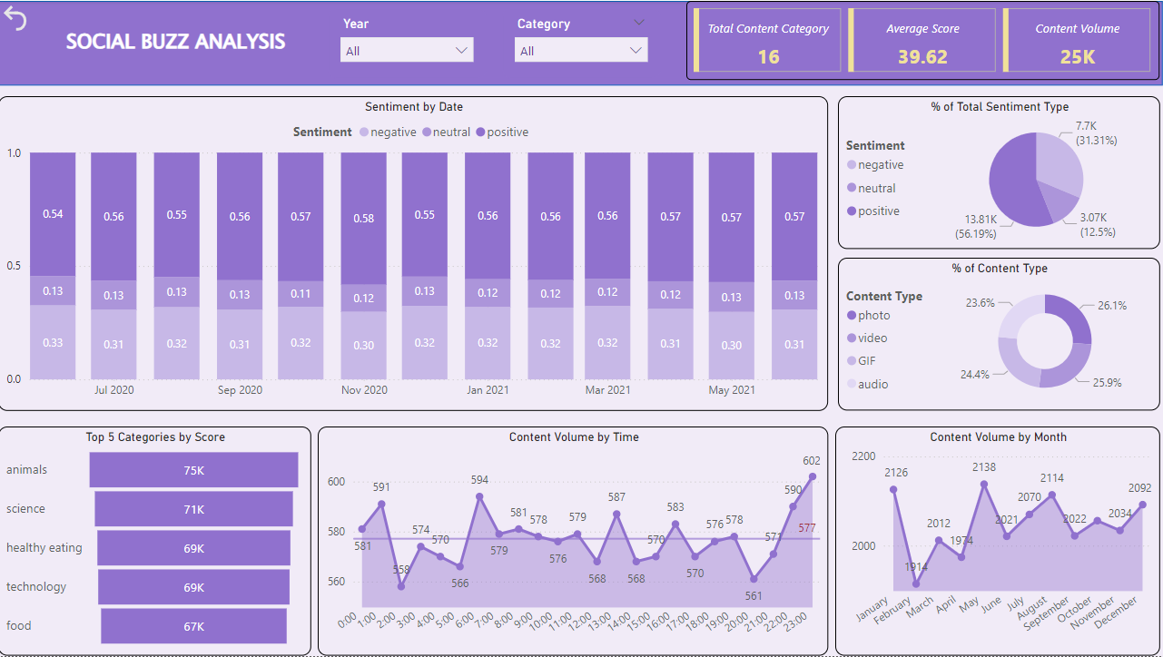
Agenda
Project Overview
Data Analysis Process
Analysis Summary
Key Insights
Recommendations
Dashboard Demo

Slide 3
Project Overview
Problem
Social Buzz, a rapidly expanding social media platform, is seeking a detailed analysis to enhance content performance and user experience based on user behavior data collected over the last 12 months.
Solutions
The Data Analytics team spearheaded a three-month pilot project, leveraging SQL and Tableau to analyze content distribution trends month-over-month and perform sentiment analysis. This foundational analysis will guide strategic planning for future initiatives.
Values
The analysis is pivotal for refining best data practices, understanding company growth, user engagement, and product categories, all of which are crucial as the company prepares for an upcoming IPO.

Slide 4
Data Analysis Process
A
B
C
Data Understanding
- 500 Million active users
- 100,000 pieces of contents
- 1 year timeframe
Data Cleaning
Features:
Content + Reactions
- EDA & Data quality check process
- Distribution, Null values, imputation, etc.
Data Analysis and Visualization
- Data analysis using SQL
- Performance monitoring using Tableau

Slide 5
Analysis Summary
Stable contents growth of Social Buzz
Social Buzz produced avg 2K posting each month without notable fluctuation, indicating a stable engagement of the app by users.
Sentiment analysis shows 56.2% of users reacted positively, 12.5% neutrally, and 31.3% negatively to the content.
User Engagement shows particular interested time window
Content posting peaks during late-night hours (10 PM-1 AM) and morning to lunchtime (6AM & 1 PM), indicating key active periods and young demographic users.
Dominant Top 3 Popular Contents Categories
Animal: had 1897 contents with an average of 39.5 sentiment score and 55.35% were positive.
Science: had 1796 contents with an average of 39.6 sentiment score and 56.5% were positive.
Healthy Eating: had 1717 contents with an average of 40.4 sentiment score and 57.4% were positive.
Opportunities also remain in the contents diversity to promote other topics and audience

Slide 6
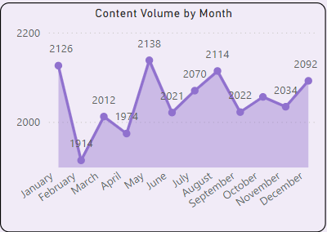
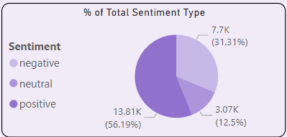
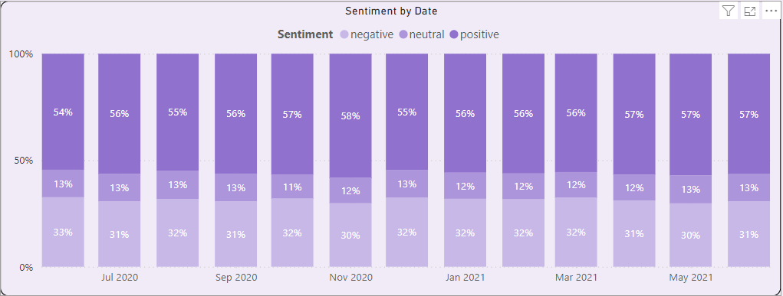
The Growth of Social Buzz
Social Buzz has been steadily growing through out the year.
User engagement remained robust with minimal fluctuations in monthly content volumes, highlighting a stable user base actively interacting with the platform.
Content posting trends show significant seasonal variation, with peak activity in January, May, and August, and lower activity during February and April.
The distribution of sentiment types remained consistent: 56% positive, 12.5% neutral, and 31% negative, indicating a predominant positive engagement across the platform.

Slide 7
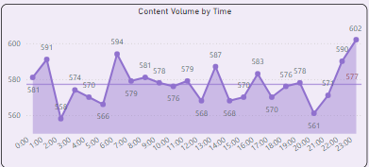
User Engagement Peak Times
Multiple peak times were identified, with late-night being the most active period for user postings
Content categories were evenly distributed during the peak hours.
Strategic Implications:
Marketing Strategies: Suggest increasing marketing efforts during late-night hours to maximize user impressions and engagement.
Customer Service Enhancements: Recommend adding customer service capabilities during peak times to enhance user experience and support sustained engagement levels.

Slide 8
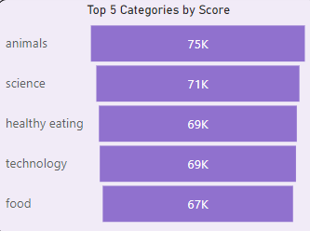
Popular Contents Categories
Animal is the top 1 most popular category by total sentiment score. Adjusting the strategies based on the data observation on “animal” of other top popular categories helps company targeting customers and retaining current customers.
For example, 32.6% of the reactions were negative. Filtering the contexts with negative elements helps improving the user experience.
Reduce contents that contains horror elements and get better understand user’s content taste to reduce the hateful interactions.
Top 3 Negative Sentiment Type
Scared
Hate
Dislike

Slide 9
Recommendations
Content Growth & Seasonality
Social Buzz consistently demonstrates growth in content engagement, marked by distinct seasonality patterns. Market efforts should be developed to capitalize on peak and off-peak seasons effectively.
User Demographics & Engagement
Data suggests a predominantly young user base, characterized by significant late-night activity. Marketing efforts should be specifically tailored to engage this demographic, supported by enhanced late-night customer service to maximize user interaction.
Content Diversity
While the top three content categories currently dominate, there is potential to diversify offerings. Exploring a wider variety of content could engage a broader audience and foster new areas of growth.
Sentiment Management
Efforts to amplify positive sentiment will be prioritized, including the strategic filtering of content to reduce negative expressions and enhance overall user experience.

Slide 10
Q & A

